Slide 1
Indoor Localization system using Time of Flight in UWB spectrum
Anirban Ghosh
Albert Davies
Tejus Siddagangaiah

Slide 2
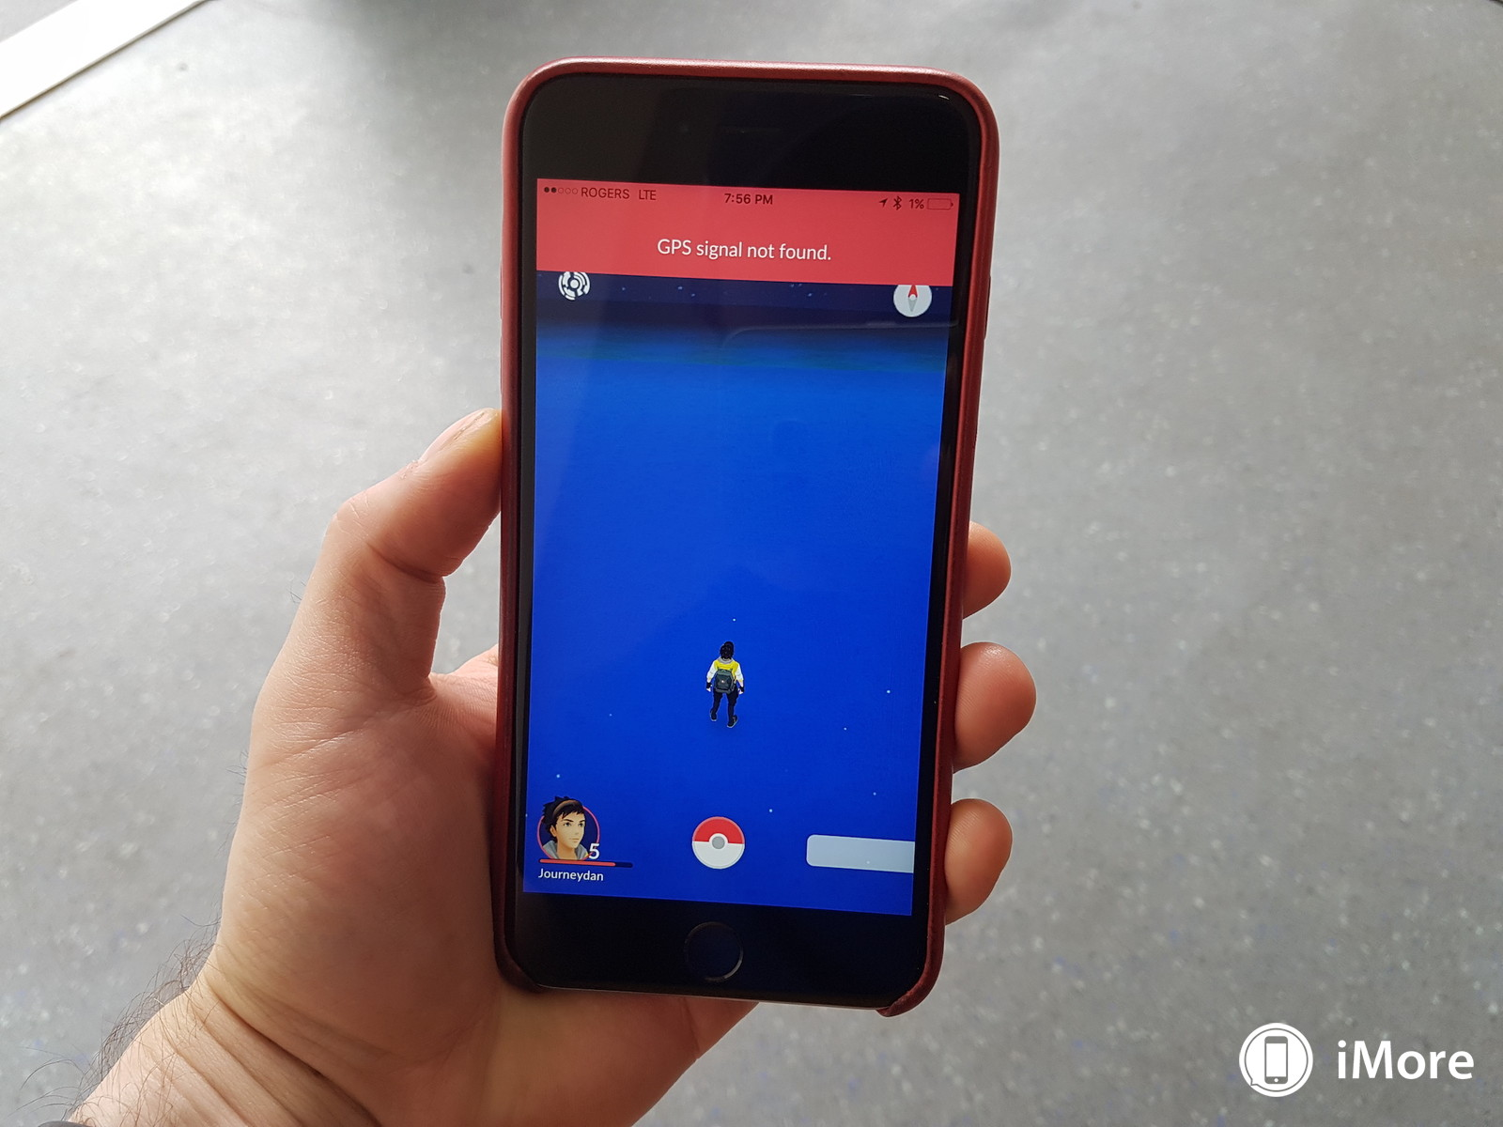
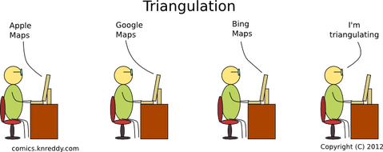
Objective
Compute a mobile node’s position in 3 Dimension in an indoor setting

Slide 3

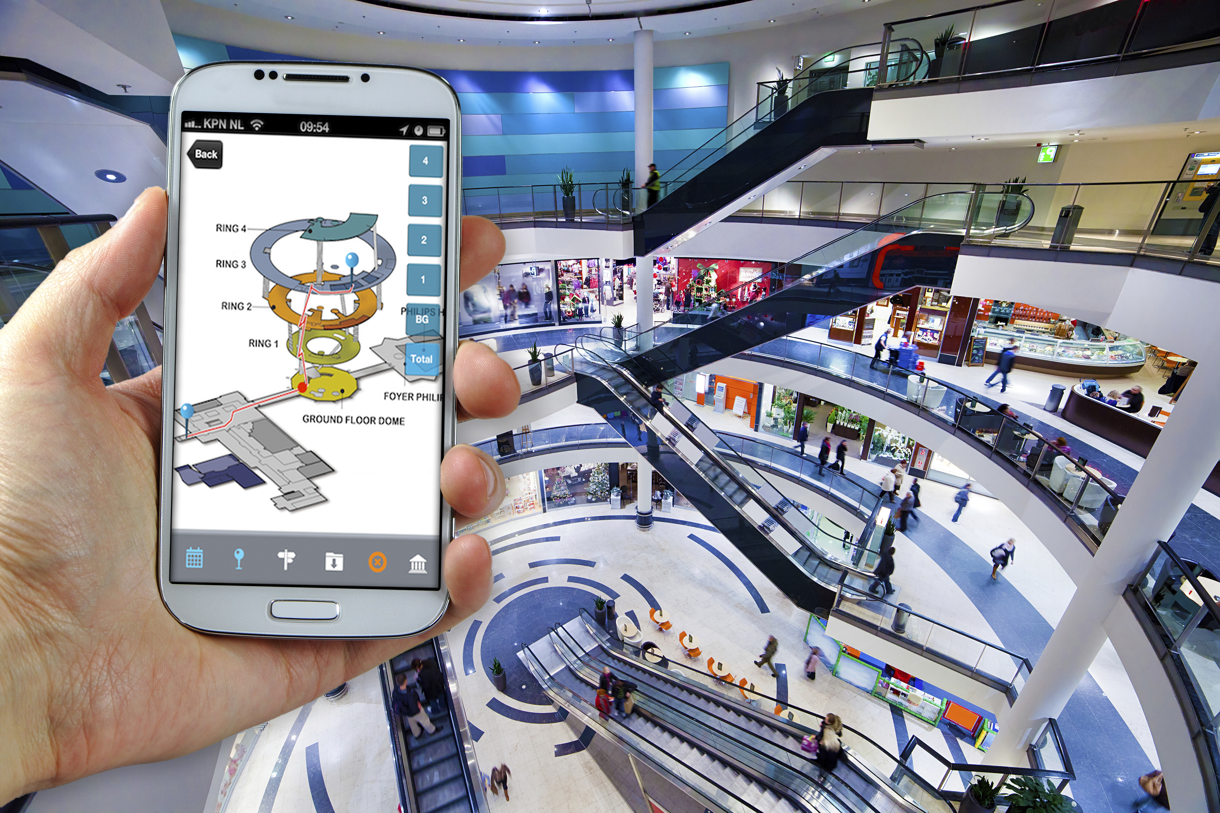

Application and Use Cases
Indoor Localization systems can be developed and applied to any large venue: Shopping Malls, Airports, Universities, etc.
Indoor Localization systems can be used to provide directions, provide relevant advertisement, raise requests for help, asset tracking etc.
Similar localization systems can also be used in remote environments like coal mines to track coal miners
Image source: Google

Slide 4




Approaches to achieve localization
BLE
Ultrasound
WiFi
UWB
Zigbee
Cameras
LEDs

Slide 5
System Architecture and Design
Admin System
PC/Laptop
Aruduino Uno Wifi
Atmega 328
Network Processor
Decawave
DW1000 Module
WiFi
SPI
Peripherals and Power Management
Arduino Uno Wifi
Atmega 328
Network Processor
Decawave
DW1000 Module
SPI
Anchor Node - I
Peripherals and Power Management
Mobile Node
Arduino Uno Wifi
Arduino Uno Wifi
Atmega 328
Network Processor
Atmega 328
Network Processor
Decawave
DW1000 Module
Decawave
DW1000 Module
SPI
SPI
Peripherals and Power Management
Peripherals and Power Management
Anchor Node - III
Anchor Node - II

Slide 6
System Diagram of a Node
Arduino Uno Wifi
Atmega 328
Network Processor
Decawave
DW1000 Module
SPI
Peripherals and Power Management

Slide 7
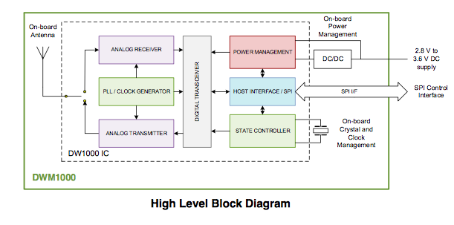
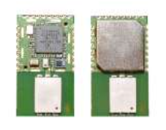
DWM1000 Module
IEEE802.15.4-2011 UWB Compliant (Operates from 3.5 – 6.5 GHz)
Locates objects to a precision of 10cm indoors
Up to 290m LOS
Highly immune to multipath fading
Factory trimmed
Integrated Antenna

Slide 8
Localization schemes
DWM1000 Modules can be used in two modes:
2 – way ranging (Time of flight)
Time Difference of Arrival(TDOA)

Slide 9
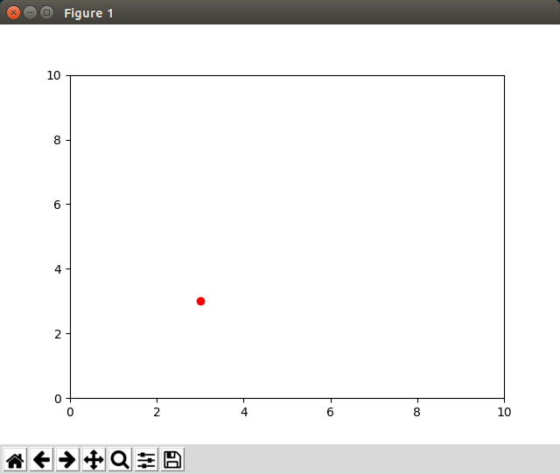
MID Semester Presentation
Achieved distance ranging in 1 dimension with visual front-end

Slide 10
DWM1000 Distance Ranging Accuracy
Not accurate for short distances out of the box.

Slide 11
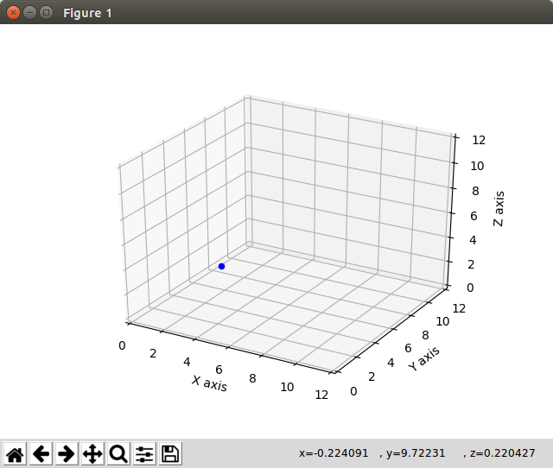
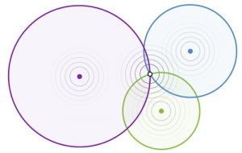
Current State of Project
Localization working!!
Localization working!!

Slide 12
But...
Increase accuracy
Constrain co-ordinate space
Sensitive to Anchor Placement
Integrate WiFi

Slide 13
Timeline
Week | Milestone | Status
Mar 27-31 | Basic Arduino Code test, Solder 2x DW1000 modules, breadboard prototyping, Py interface | Done
Apr 3-7 | Mid term demo. Level shifters interface, DW1000 baseboards arrive, Perf board bring up | Done
Apr 10-14 | Develop TOF code with 5 DW1000 modules working at once. | Done
Apr 17-21 | Change library for robust multi-anchor network connectivity and addressing | Done
Apr 24-28 | Test TOF Code with 4 anchor+1 tag. Accuracy measurements, integrating solver code with python interface code and GUI extension | Done
May 1-5 | Prep for final demos, code and H/W cleanup, calibrations, WiFi Integration | Pending

Slide 14
Final Demonstration
Final demonstration: Use multiple anchor nodes whose locations are pre-determined to track the mobile node in the same environment. Display the movement of the mobile node on a GUI(using a PC application) in real time

Slide 15
Questions?

Slide 16
ANCHOR 0
TAG
ANCHOR 1
ANCHOR 2
POLL
POLL_ACK
RANGE_INIT
time
RANGE
Tag to Admin via WiFi

Slide 17
ANCHOR – 1 (0, 0, 2.34)
ANCHOR – 3 (0, 3.6, 2,34)
Z - axis
y- axis
ANCHOR – 0 (0, 0, 0)
x - axis
ANCHOR – 2 (4.63, 0, 2.34)

